Slide 1

PORT AND PROTOCOLS

Slide 2
LEARNING OBJECTIVES
Ports are identified with numeric IDs and are associated with specific protocols, processes, or services.
It essentially allows different network devices to communicate with each other. Protocols include HTTP, TCP/IP, and SMTP among numerous others.

Slide 3

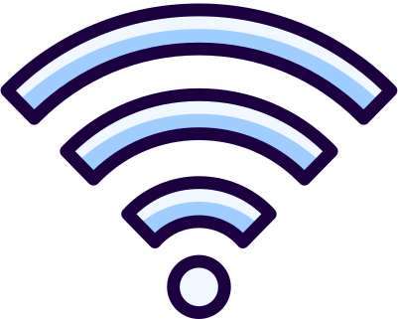
A network consists of two or more connected devices that communicate with each other.
To communicate, these devices use protocols.
NETWORK PROTOCOLS
Protocol means a rule that defines how devices will communicate with each other.

Slide 4
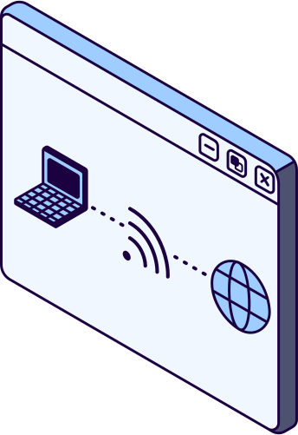

HTTP
HTTPS
Hypertext Transfer Protocol
Hypertext Transfer Protocol Secure
This is the protocol used by a web browser to make requests to a web server for a webpage. If there is an error with the request, it will return a code (e.g. 404).
This protocol works in the same way as HTTP but data transfers are encrypted to prevent interception from hackers.
WEB PROTOCOLS

Slide 5

Servers are dedicated network devices for storing files to be accessed by other devices on the network.
FILE TRANSFER
Protocol
A web server stores files for a website.
FTP (File Transfer Protocol) allows files to be uploaded to a server. It requires authentication (i.e. username and password) to access the server.
FTP can also be used to download files, particularly those with large file sizes.

Slide 6

EMAIL PROTOCOLS
POP
SMTP
IMAP
Post Office Protocol
Simple Mail Transfer Protocol
Internet Message Access Protocol
Requests new received emails from a server. The server returns new emails if there are any.
Sends an email to a server to be sent to its intended recipient. This protocol sends email only.
Synchronises email clients with the server to both send and receive emails. This is accessible across devices.

Slide 7
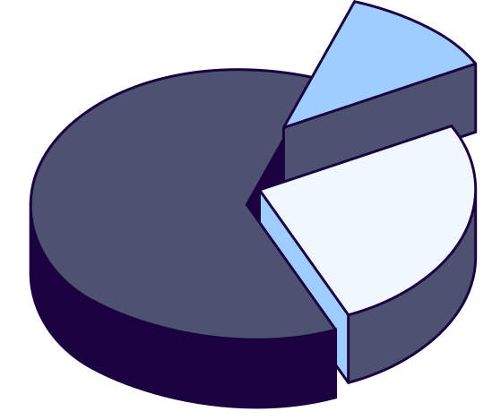

Transmission Control Protocol
TCP enables data to be sent over the internet (server to client or vice versa). TCP does this by splitting data into packets to send. TCP is reliable because any missing packets are always resent.
TRANSPORT PROTOCOLS
User Datagram Protocol
UDP performs the same function as TCP. However, it is not reliable because any missing packets are discarded. UDP is faster for some data (e.g. streaming).

Slide 8
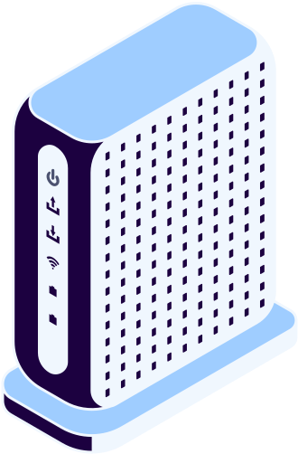
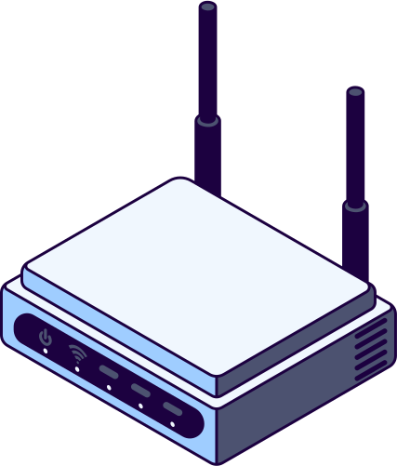
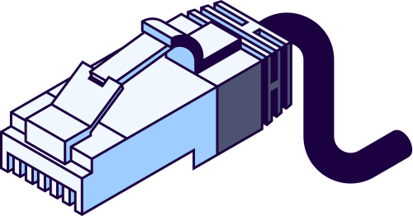
NETWORK AND LINK PROTOCOLS
IP
Ethernet
Wi-Fi
Internet Protocol (IP) packages the packets made by TCP or UDP and adds a destination for the packets (IP address).
Ethernet is a family of related protocols that links the packets of data and LAN hardware (e.g. switches, routers).
WLAN (Wi-Fi) is another family of related protocols that links data packets and hardware components to be used wirelessly.

Slide 9
WELL-KNOWN PORTS (0–1023)
HTTP (PORT 80, TCP)
HTTPS (PORT 443, TCP)
FTP (PORTS 20, 21, TCP)
SMTP (PORT 25, TCP)
POP3 (PORT 110, TCP)
IMAP (PORT 143, TCP)
DNS (PORT 53, TCP/UDP)
SSH (PORT 22, TCP)
TELNET (PORT 23, TCP)
DHCP (PORTS 67, 68, UDP)

Slide 10
REGISTERED PORTS (1024–49151)
MYSQL (PORT 3306, TCP)
PostgreSQL (Port 5432, TCP)
RDP (Port 3389, TCP)
SNMP (Ports 161, 162, UDP)

Slide 11
DYNAMIC/PRIVATE PORTS (49152–65535)
RESERVED FOR DYNAMIC OR PRIVATE USE.
Commonly used for temporary connections by applications.

Slide 12
POP
TCP
FTP
Drag and drop the network protocols into the correct category.
HTTPS
IP
SMTP
IMAP
HTTP
UDP
Web/Files
Email
Transport

Slide 13
Drag and drop the network protocols into the correct category.
Web/Files
HTTP
HTTPS
FTP
Email
POP
SMTP
IMAP
Transport
TCP
UDP
IP

